Slide 1
Exploratory Data Analysis
Amit Pingale
Himani Solanki
Shubham Patel

Slide 2
Why Exploratory Data Analysis?
Maximize insight into a data set;
Uncover underlying structure;
Extract important variables;
Detect outliers and anomalies;
Test underlying assumptions;
Develop parsimonious models; and
Determine optimal factor settings.

Slide 3
Things to keep in mind before starting.
1. Form hypotheses/develop investigation themes to explore
3. Wrangle data
3. Assess quality of data
4. Profile data
5. Explore each individual variable in the dataset
6. Assess the relationship between each variable and the target
7. Assess interactions between variables
8. Explore data across many dimensions

Slide 4
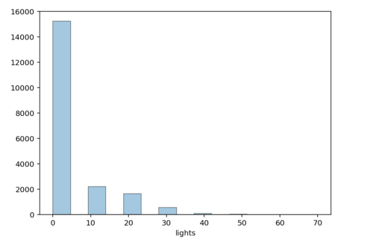
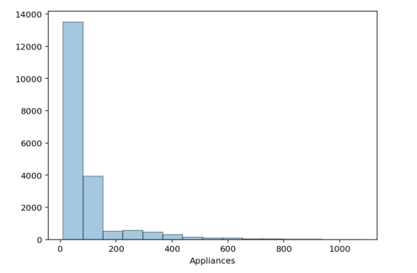
Energy Consumption
Histogram analysis

Slide 5
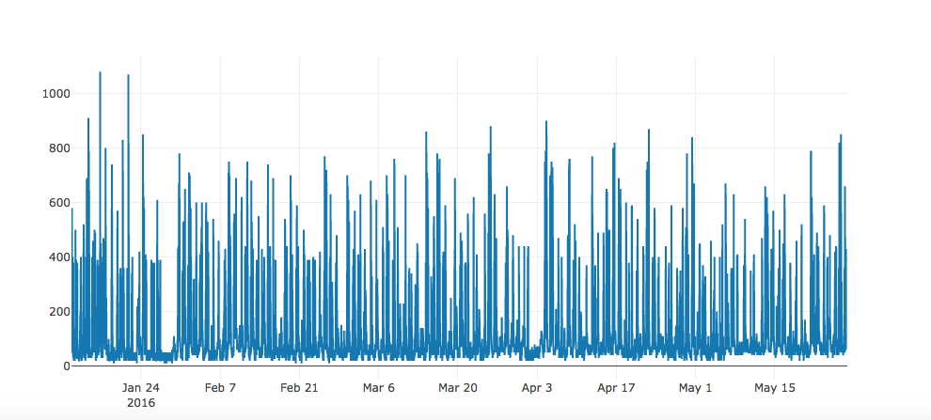
Energy consumption of appliances in 1st quarter of year

Slide 6
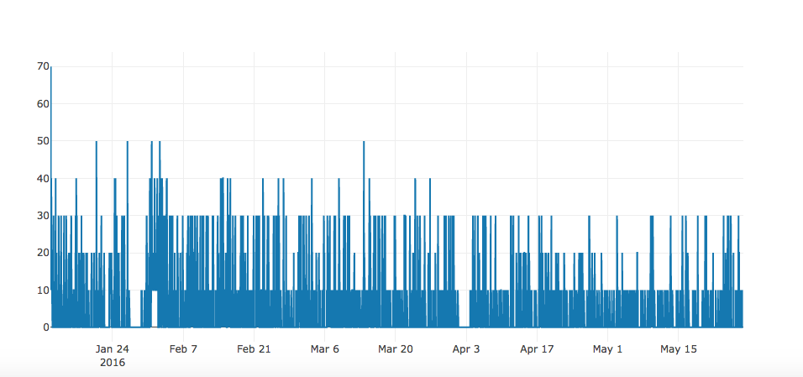
Energy consumption of lights in 1st quarter of year

Slide 7
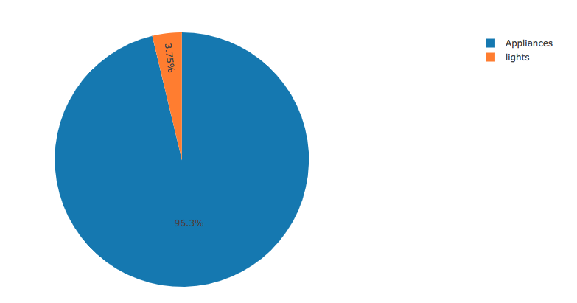
Energy consumption ratio

Slide 8
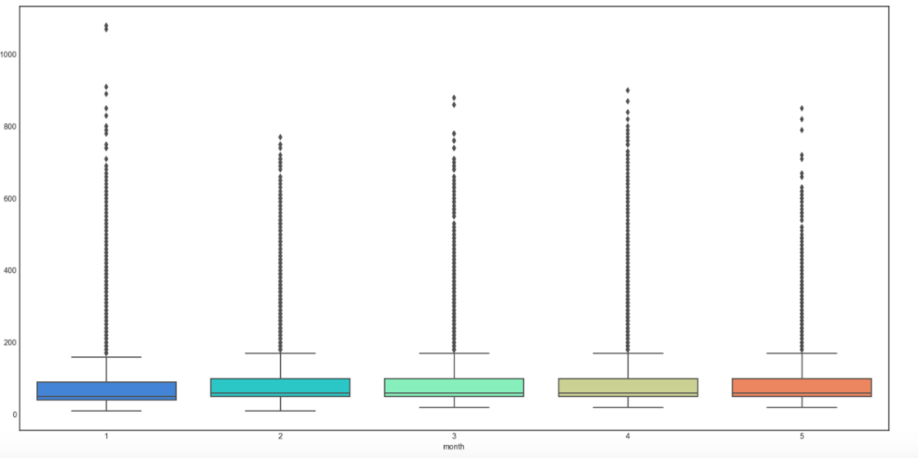
Analysis for monthly consumption of energy by appliances

Slide 9
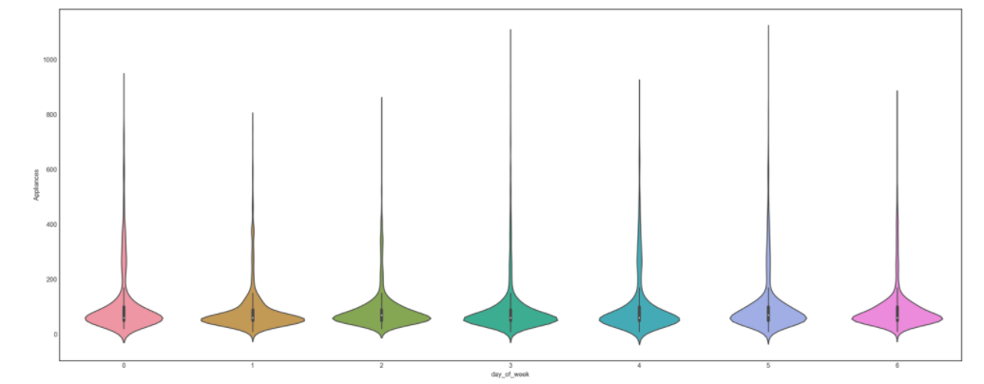
Analysis for weekly consumption of energy by appliances

Slide 10
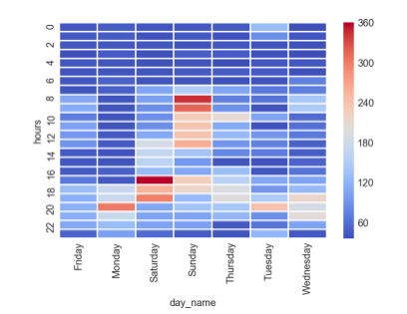
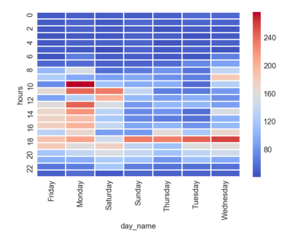
January
February
Analysis for hourly consumption of energy by appliances

Slide 11
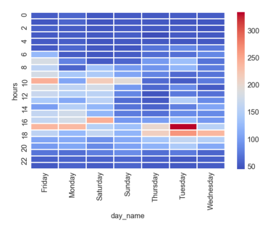
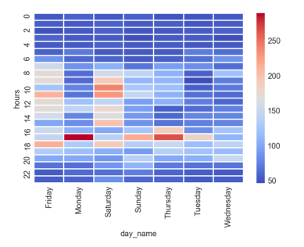
March
April
Analysis for hourly consumption of energy by appliances

Slide 12
May
Analysis for hourly consumption of energy by appliances

Slide 13
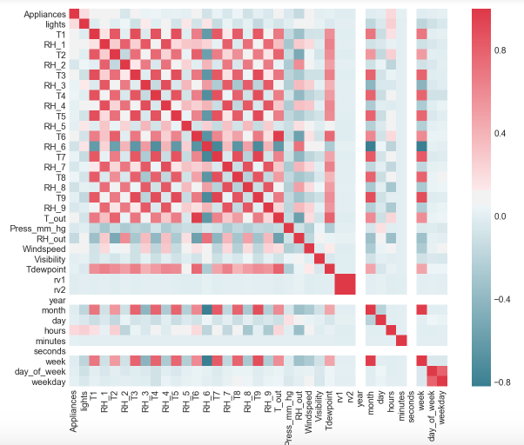
Correlation Matrix

Slide 14
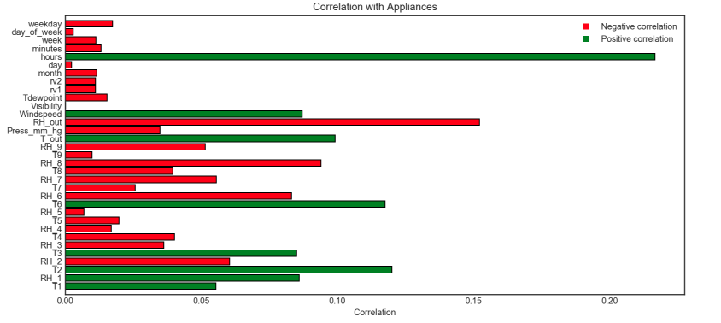
Correlation of Aplliances with other dependent features

